Slide 1


Advanced Physics Lab I
Donghun Jung
2020312141
Intensity Analysis of
Polarized Raman Spectroscopy for c-Si

Slide 2
Outline
Outline
Intro
/Theory
Symmetry in Physics
Symmetry in the material
Experiment
/Results
Raman Spectroscopy
c-Si
Raman Intensity
Experiment Result
Discussion
/Conclusion
Raman

Slide 3

Symmetry in Physics
Parity Transformation
Symmetry
A system remains unchanged after being subjected to a variety of transformations or operations.

Slide 4
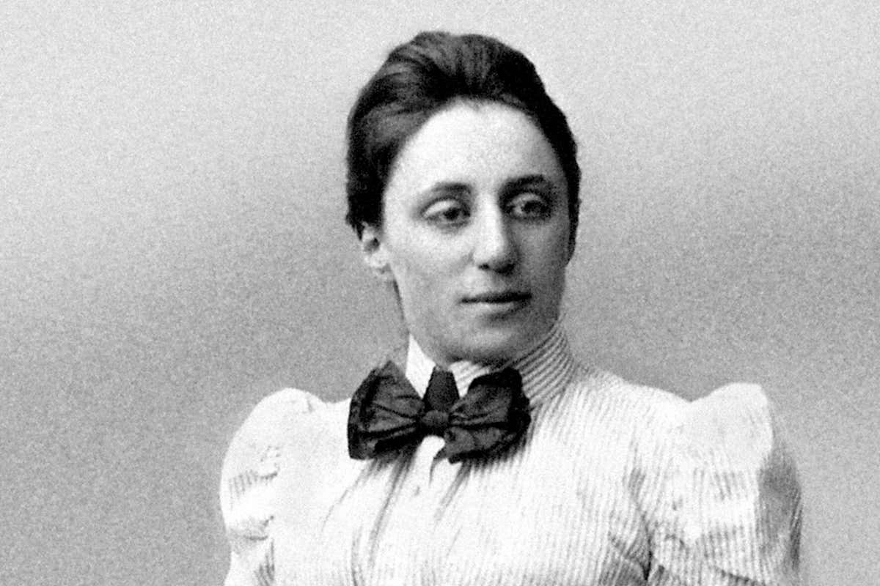



Symmetry in Physics
Symmetry
A system remains unchanged after being subjected to a variety of transformations or operations.
Noether Theorem
every differentiable symmetry of the action of a physical system with conservative forces has a corresponding conservation law.
Time-Reversal Transformation
Energy Conservation
Spatial Transformation(Translation)
Momentum Conservation
Rotation Transformation(Translation)
Angular Momentum Conservation

Slide 5
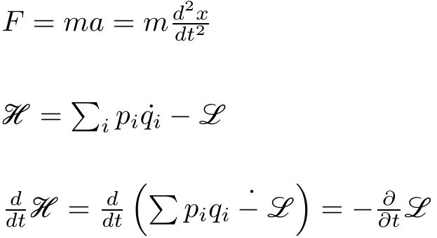

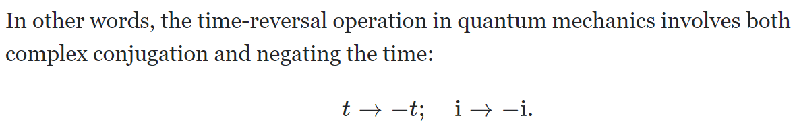
Symmetry in Physics : Example
In Classical Mechanics…
Time-Reversal Transformation
In Quantum Mechanics…

Slide 6
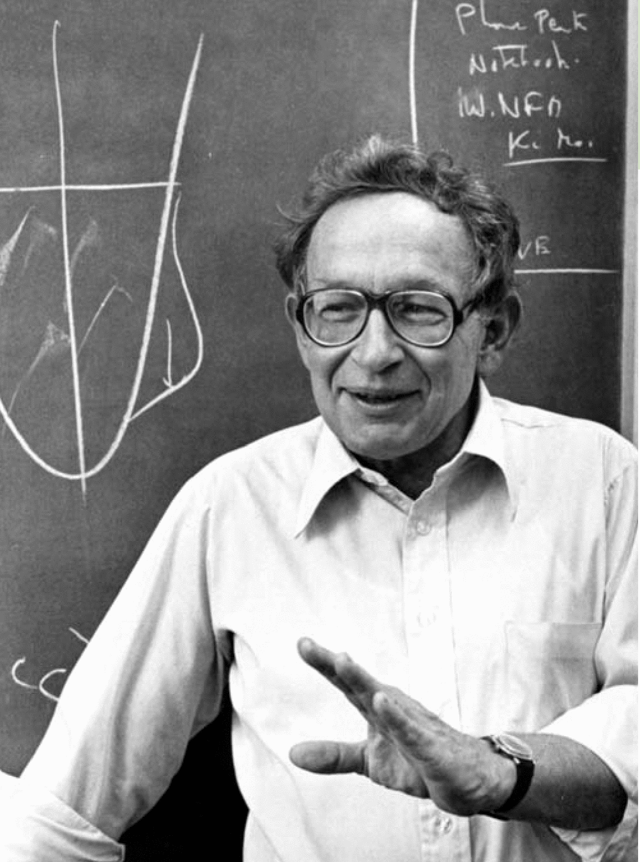
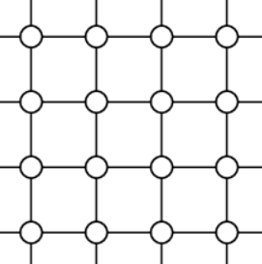
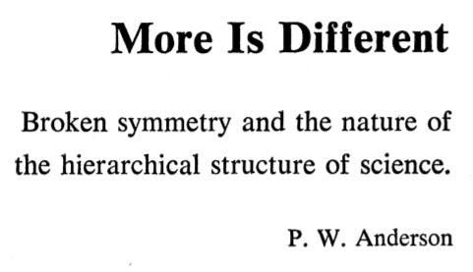
Symmetry in Material
The 'new' properties are manifested by numerous particles.
The 'new' properties are manifested by the symmetry, or symmetry breaking.
The 'new' properties are manifested by the topology. (TQC)

Slide 7
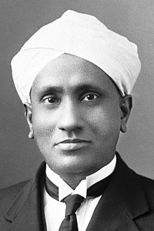
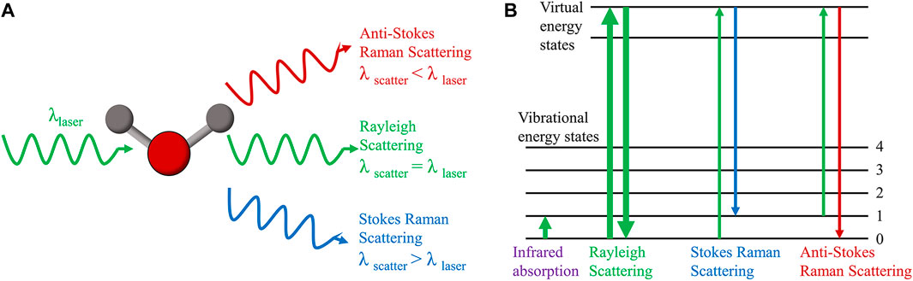
Raman Spectroscopy
Raman Shift
Raman scattering is inelastic photon scattering by matter. It is called Raman shift.

Slide 8
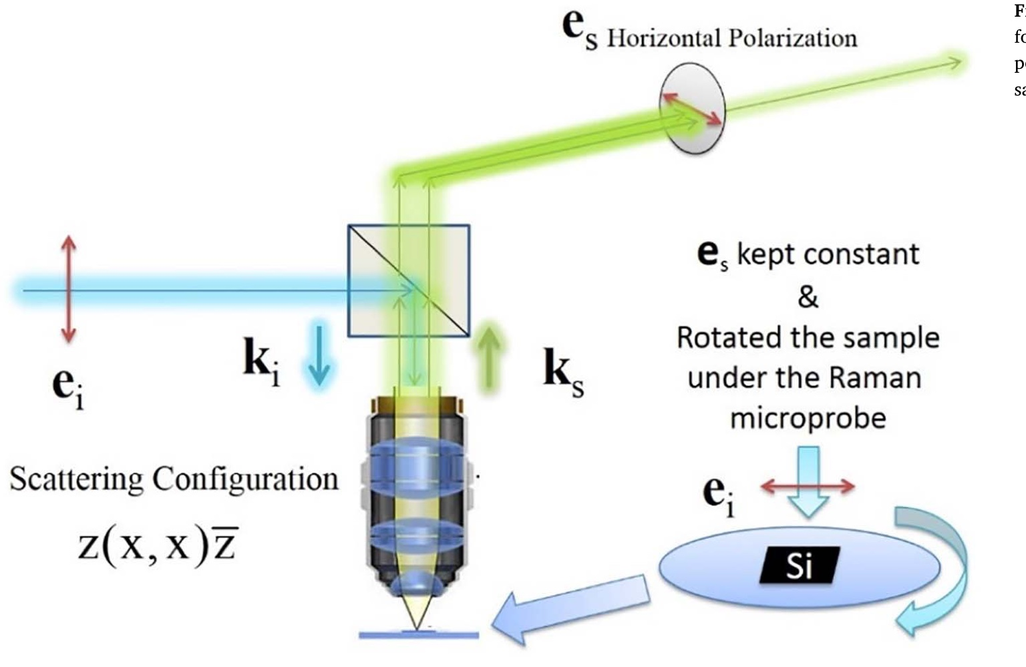
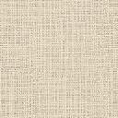
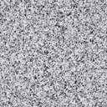
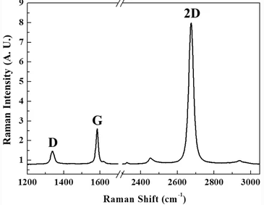
Raman Spectroscopy
Spectrometer
CCD

Slide 9
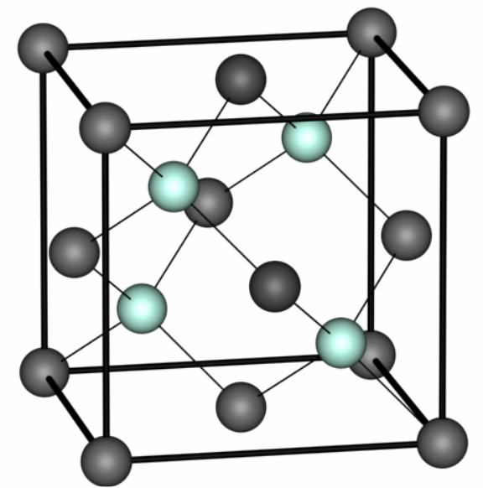
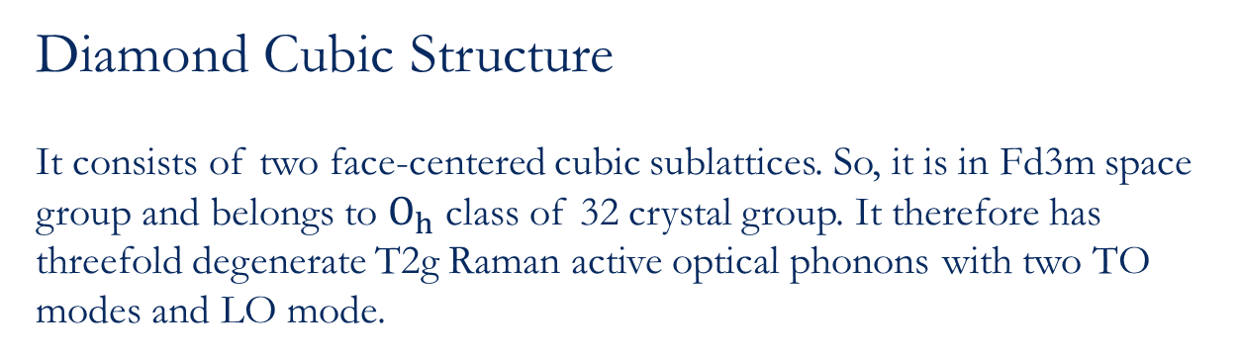
c-Si
Diamond Cubic Structure
It consists of two face-centered cubic sublattices. So, it is in Fd3m space group and belongs to $O_{h}$ class of 32 crystal group. It therefore has threefold degenerate T2g Raman active optical phonons with two TO modes and LO mode.

Slide 10
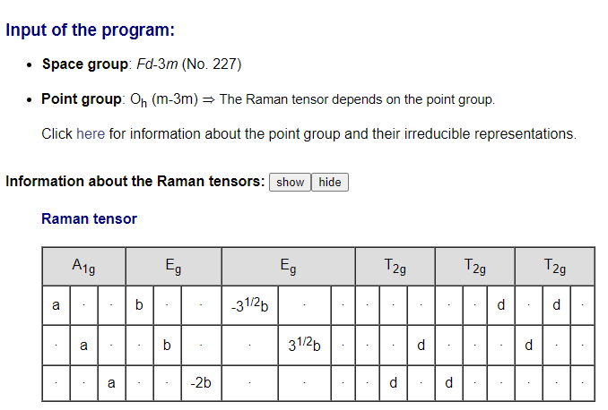
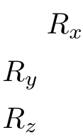
c-Si

Slide 11

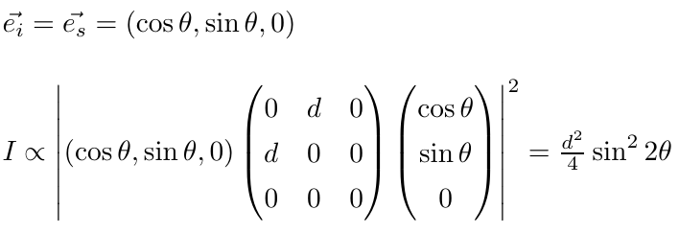
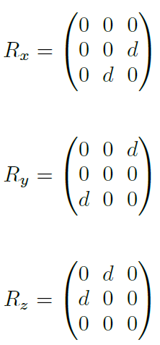
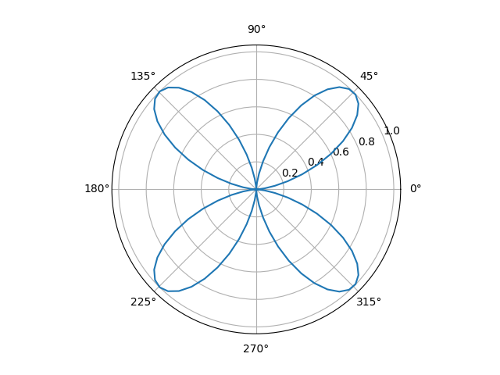
Raman Intensity : Rotating Sample and Incident beam
Polar plot for Raman Intensity
Only LO mode is allowed. There, 4 LO maximum occurred. There is 4-fold symmetry.

Slide 12
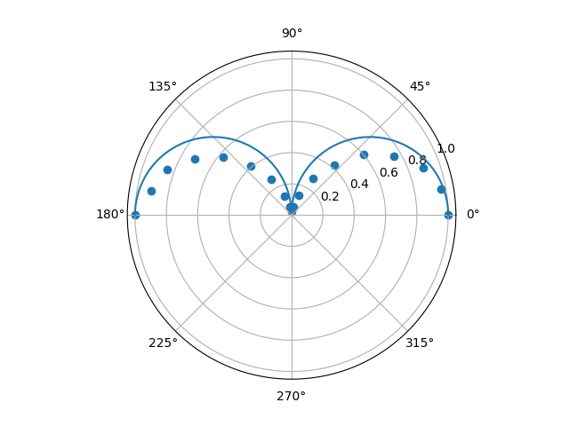
Conclusion
Polar plot for Raman Intensity
Only LO mode is allowed. There, 2 LO maximum occurred. There is 2-fold symmetry.
Raman Spectroscopy can be used to identify the symmetry of the unknown material.

Slide 13
References
[1] Uma Ramabadran, Bahram Roughani, Intensity analysis of polarized Raman spectra for off axis single crystal silicon, Materials Science and Engineering: B, Volume 230, 31-42, 2018
[2] M. Cardona, G. Güntherodt, Light Scattering in Solids, Springer-Verlag, Berlin, 1975, vol. 1–4.

Slide 14

Thank you

